Slide 1
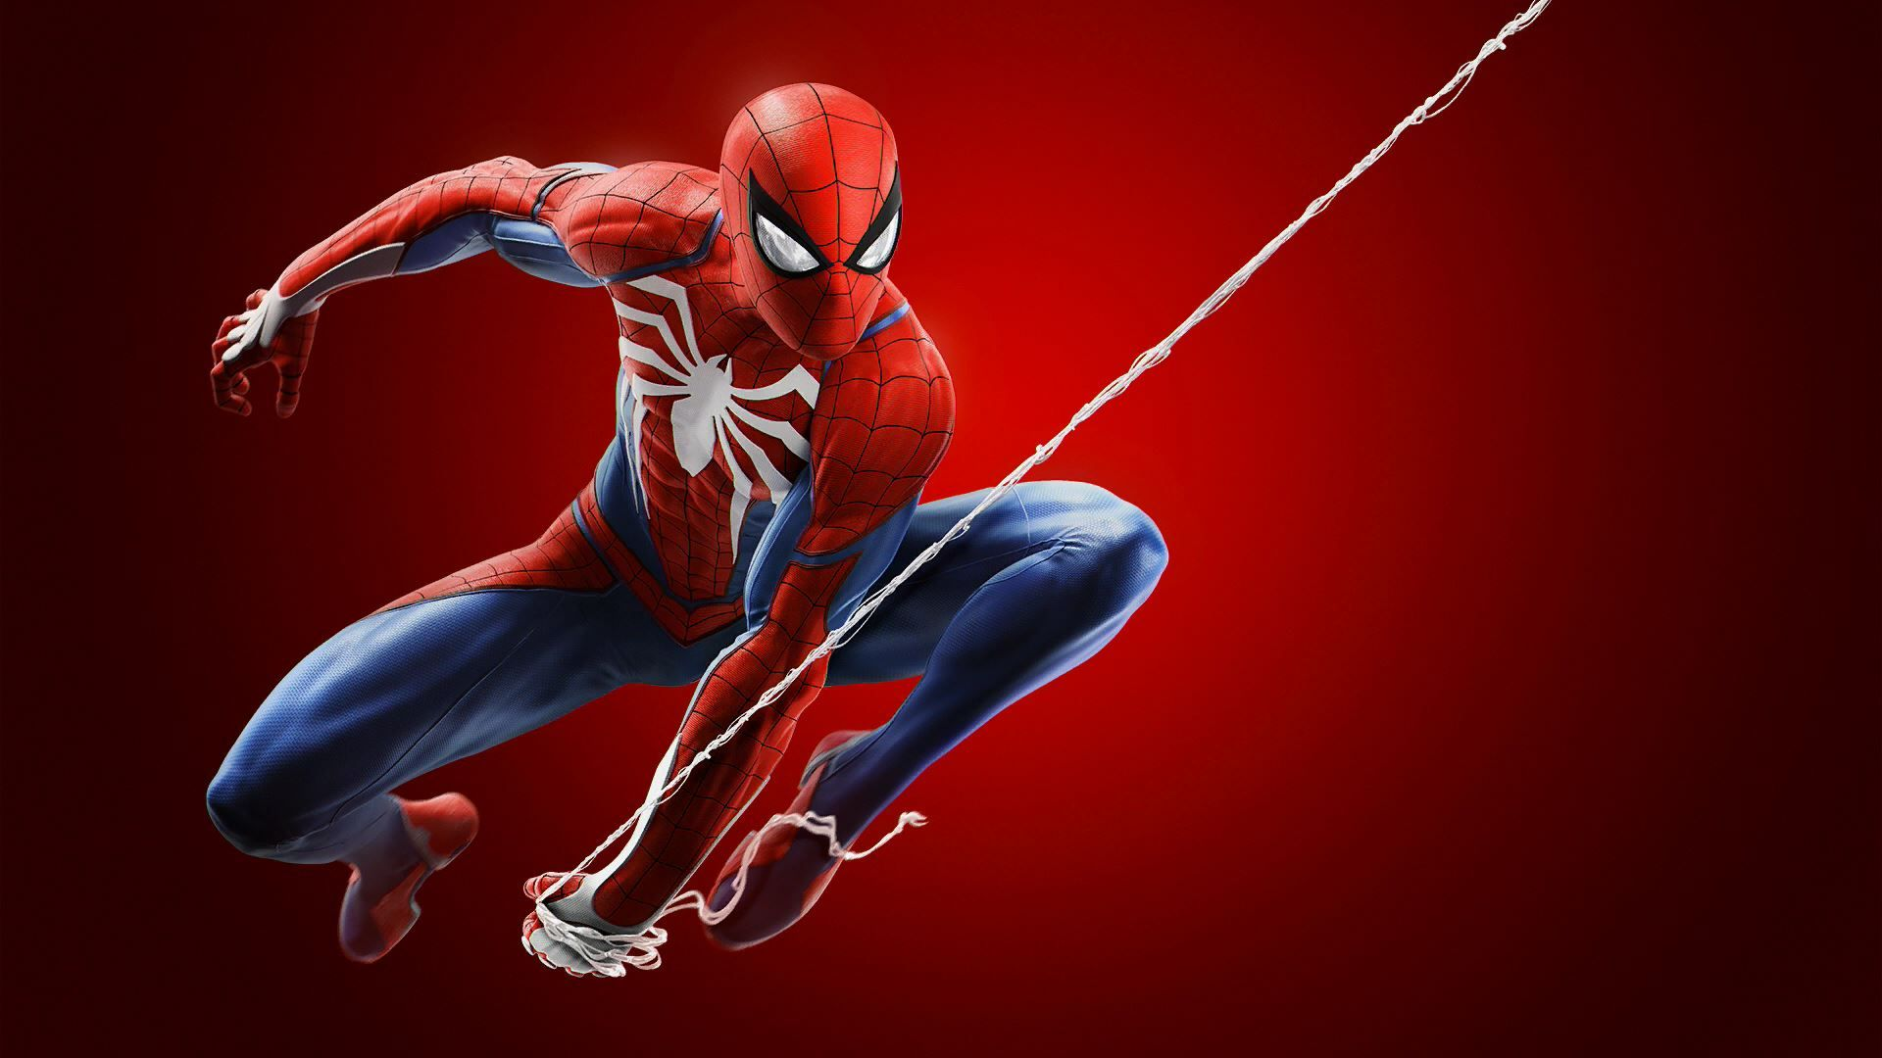
My favorite Movie
Dzhumabekov Aziret

Slide 2

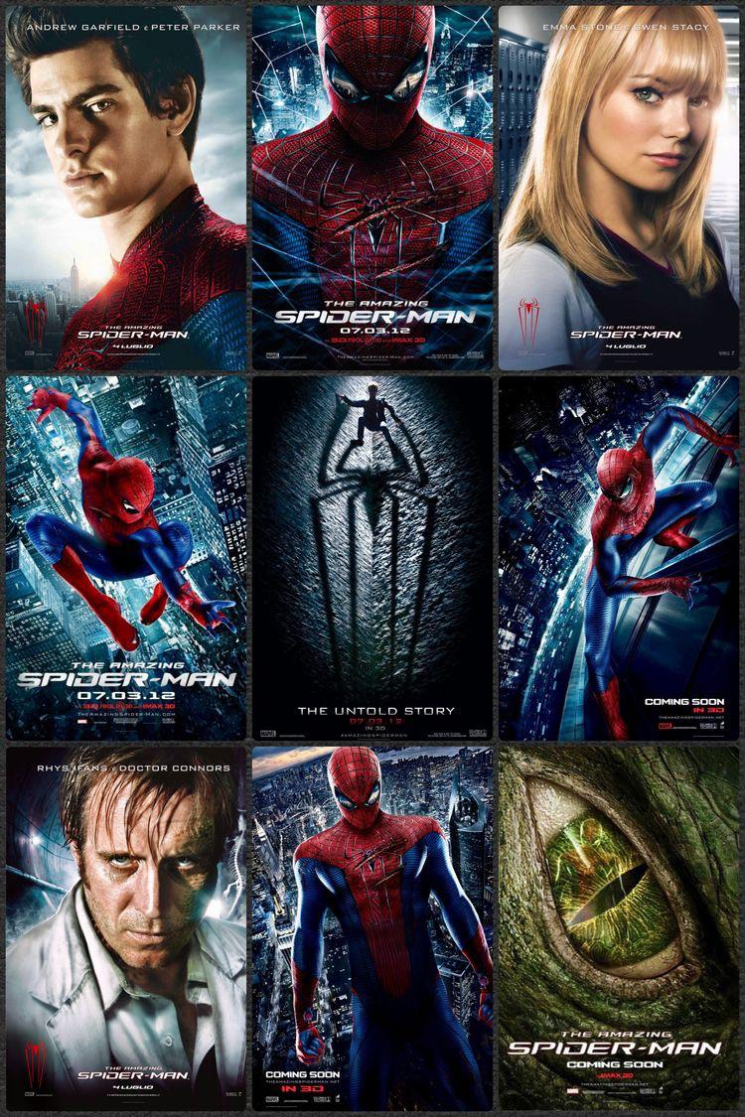
SpiderMan Film Series
I watched Spider-Man movie in 2014.
It was Amazing Spider Man(2012). When I watched that film for the first time I understood that it will be my favourite movie.

Slide 3

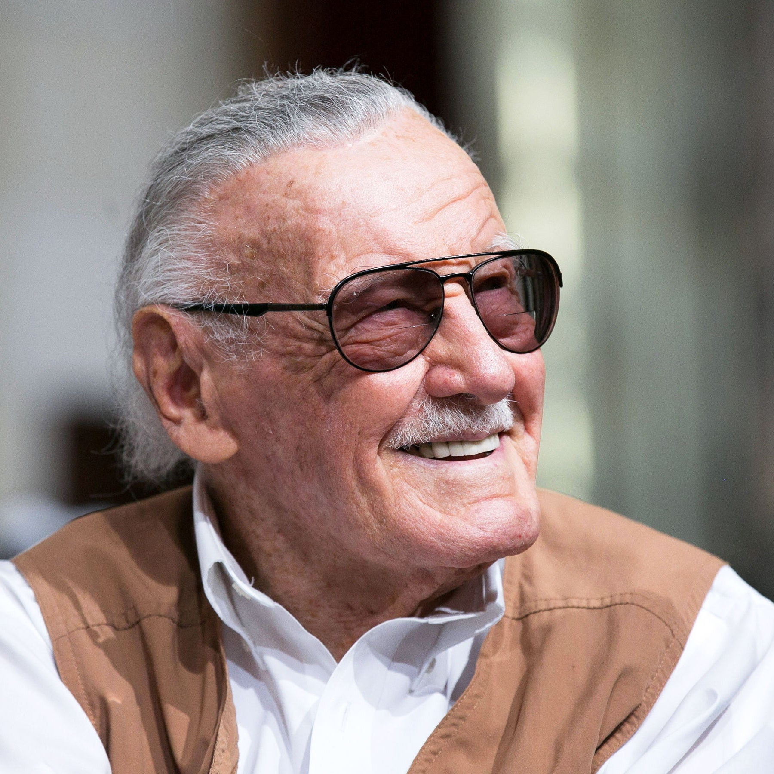

The author of SpiderMan

Slide 4
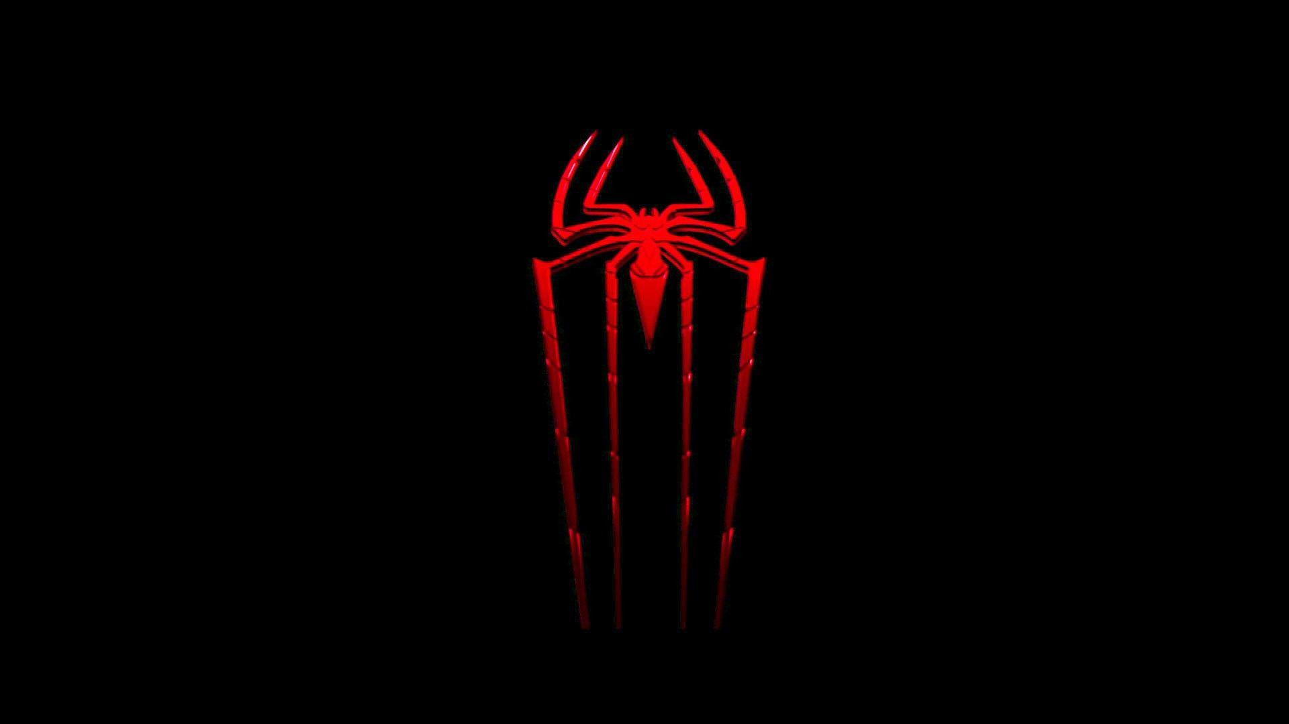
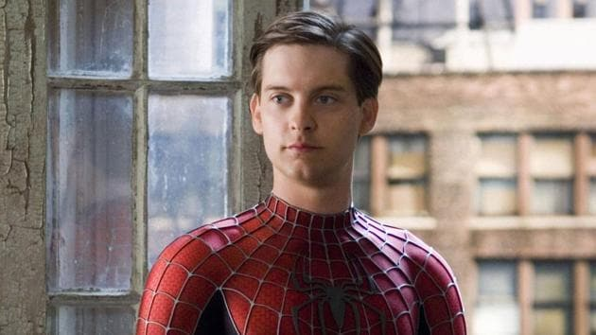
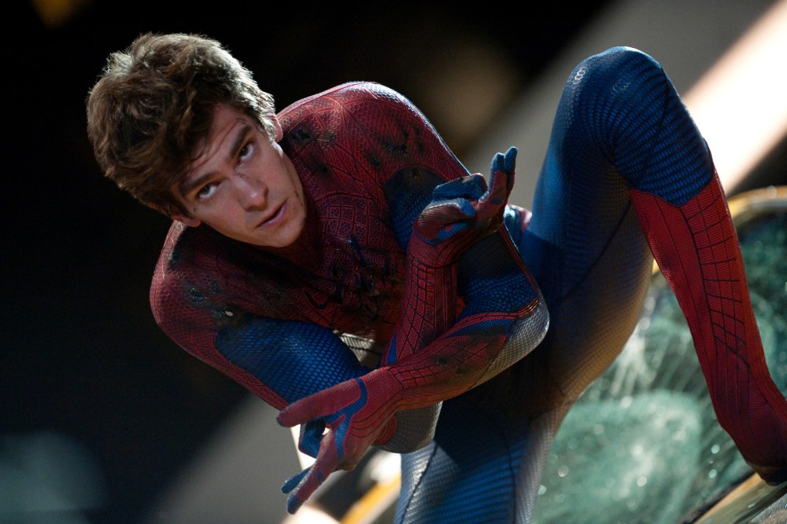
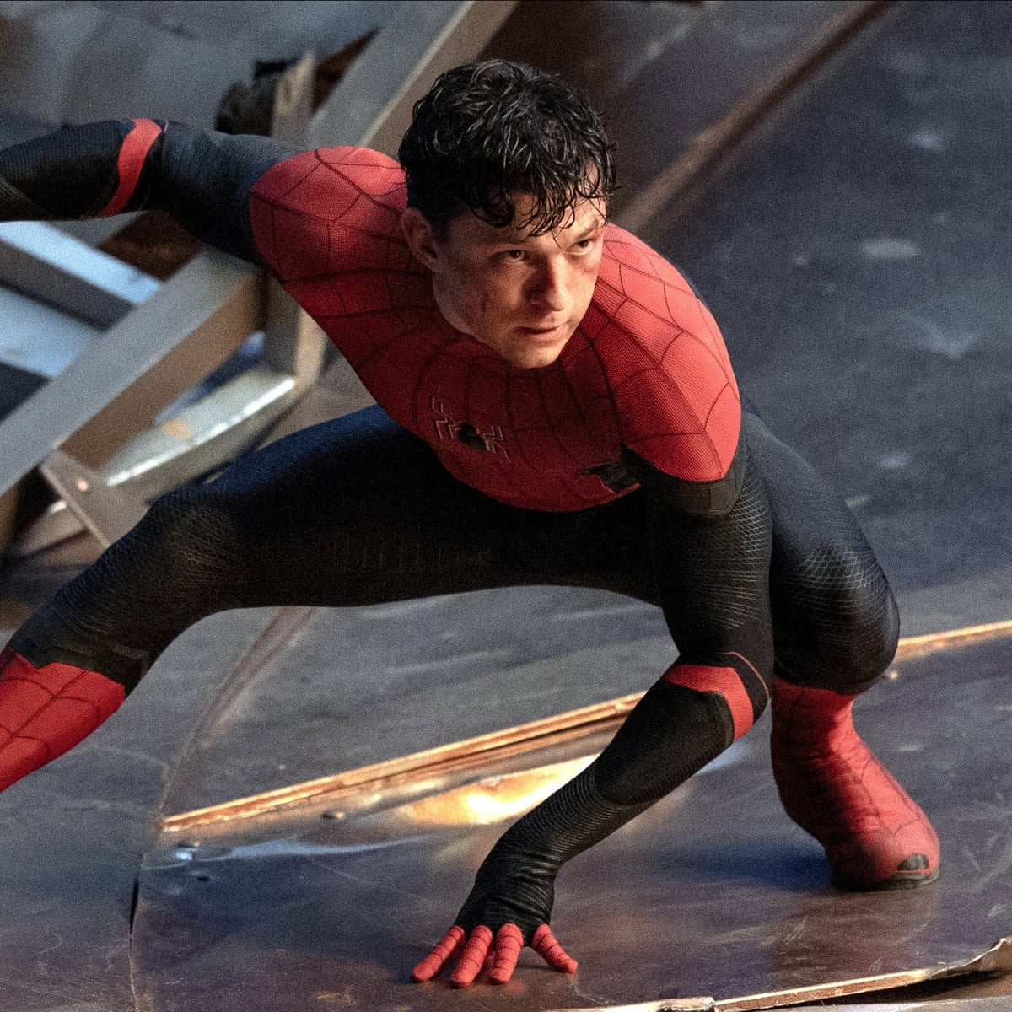
Actors of Spider-Man
There was 3 actors of Spider-Man
Tobey Maguire (2002, 2004, 2007)
Andrew Garfield (2012, 2014)
Tom Holland (2017, 2019, 2021 only Spider-Man Films)

Slide 5
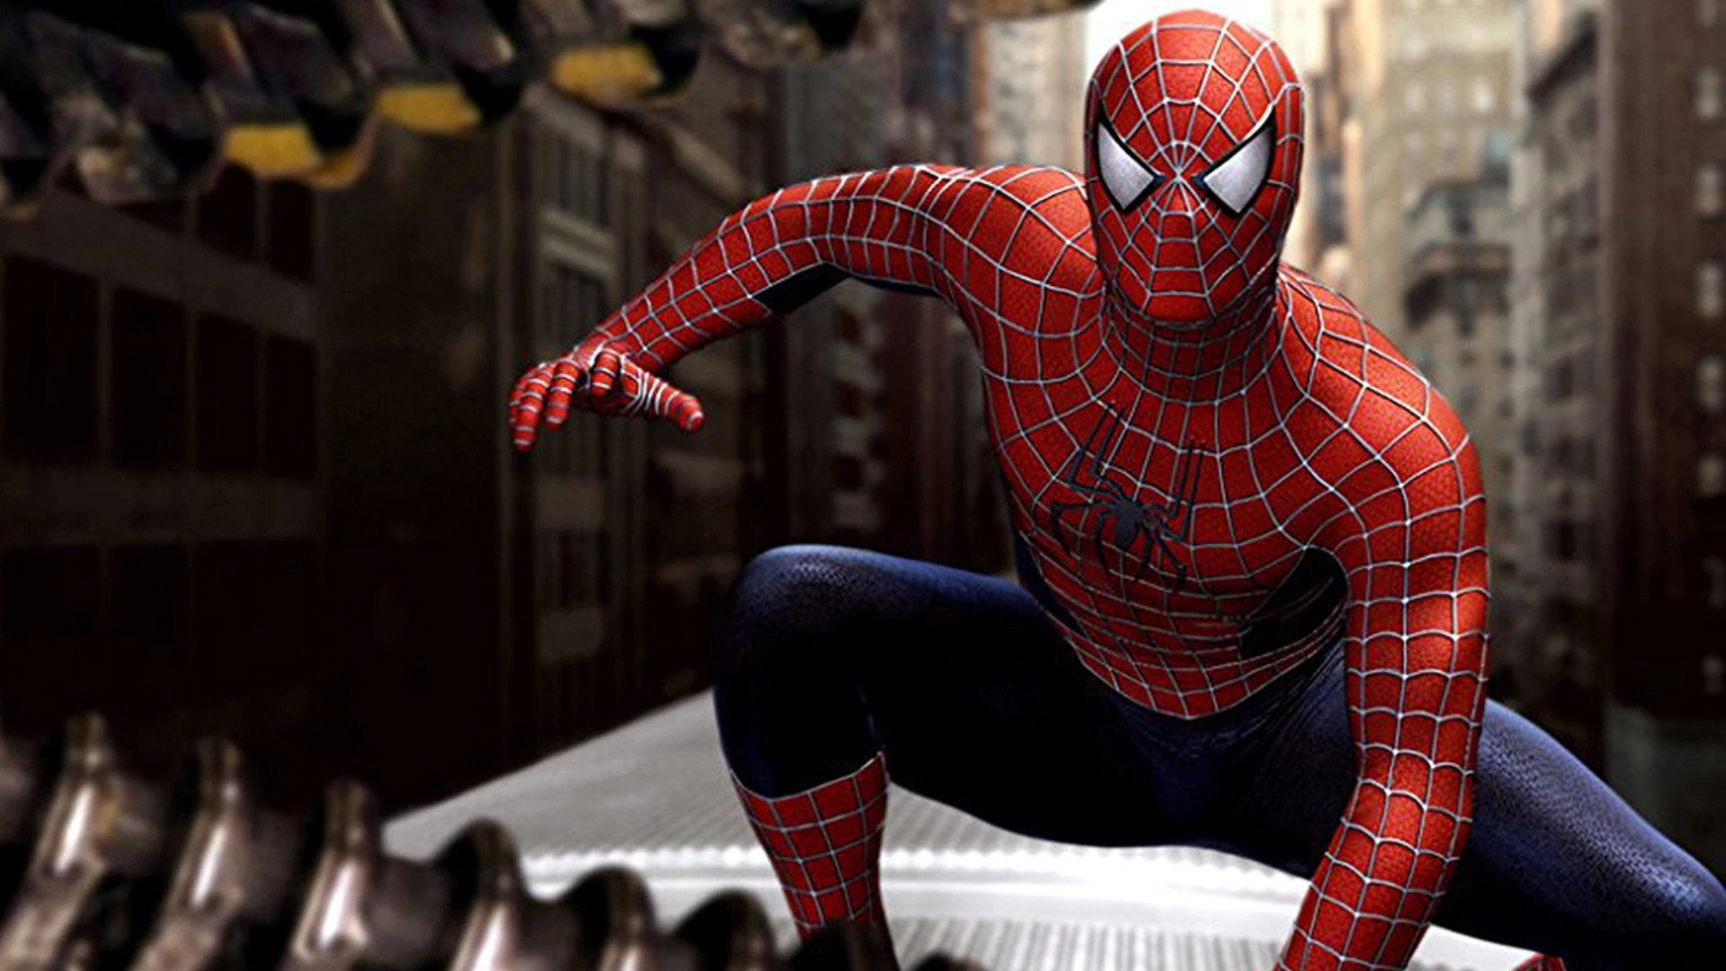
Why Spider-Man? I chose Spider-Man because of his Villains and because of it was my first movie.

Slide 6

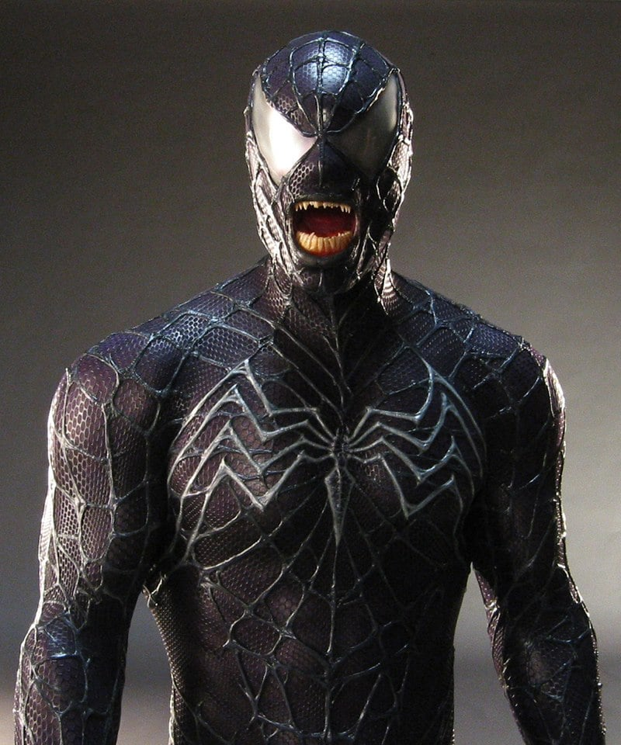
Enemies of Spider-Man
Marvel showed Venom for the first time in the film Spider-Man 3 (2007). The spider man was Tobey Maguire.

Slide 7
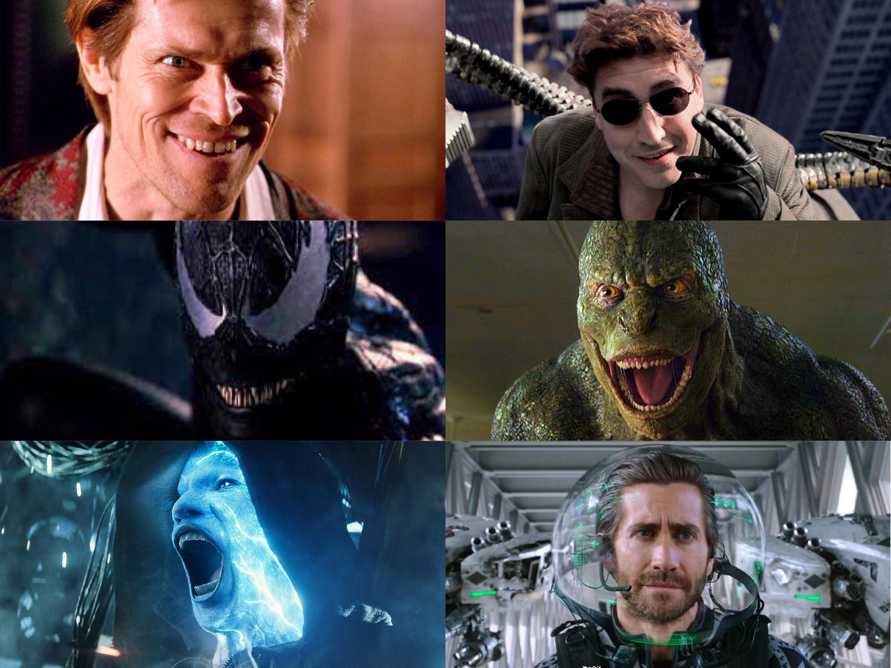

Slide 8
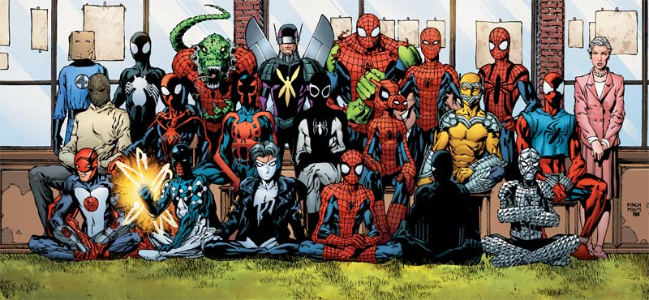
Spider Man Universe

Slide 9
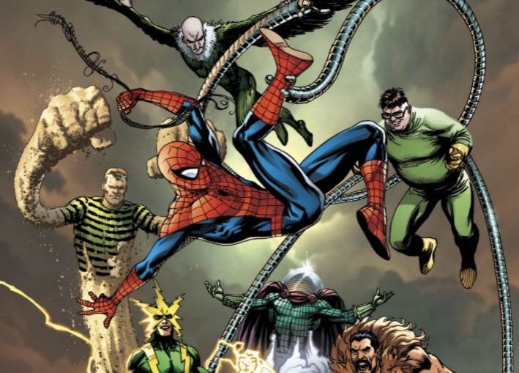
Thank you Everyone

